Slide 1
Salinity: Relationship and Effect on Dissolved Oxygen
What is the relationship?
Data Analytics Life Cycle
Subset of CalCOFI dataset

Slide 2
Why I chose this topic?: The Big Picture
Oxygen in ocean water is essential for marine life
Oxygen distribution In ocean water is affected by the amount of salinity in the water
Various organisms that breath underwater depend on sufficient amounts of dissolved oxygen to survive
Low oxygen can lead to stress among various species, migration, or even death and possible extinction

Slide 3
Research question
What effect does salinity have on the level of dissolved oxygen along the California coast?
Increasing?, decreasing?
Can we see a clear trend?

Slide 4
Background information: Why salinity is important?
Salinity: Measure of the amount of dissolved salt there is in seawater
Can be affected by evaporation and precipitation, water masses mixing, temperature and density gradients
Salinity controls seawater density which drives global thermohaline circulation (ocean conveyor belt) which regulates the Earth’s climate
Affects circulation based on how water sinks, rises, and moves horizontally
Salinity helps marine animals to regulate their internal water balance
Changes in salinity can cause things like migration, stress, or even death among various marine animals

Slide 5
Salinity and water density
Ocean water gets saltier toward the bottom and is fresher closer to the surface
Layers of salt created at deeper levels do not mix as well
Less mixing of salt at deeper levels means more oxygen gets used up by organisms living at the deeper levels who use up lots of oxygen
This causes oxygen levels to become drastically reduced over time

Slide 6
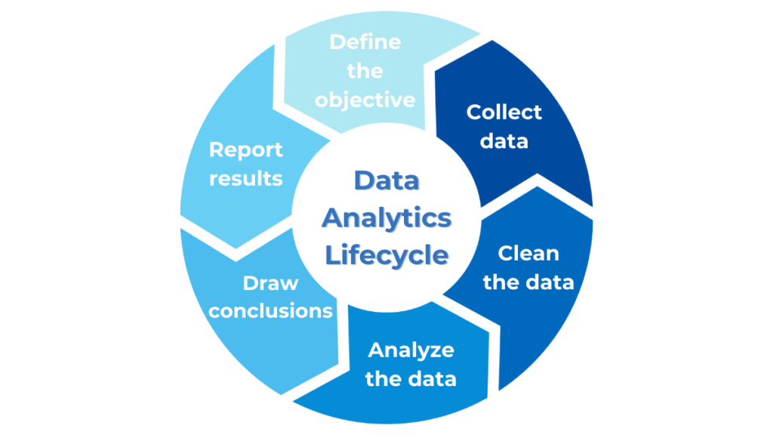
I used the data analytics life cycle…

Slide 7
Data Analytics Life Cycle
Discovery phase – defined the problem
Prepare phase – collected and organized the data
Model – I built a multi-linear regression
Analyze – I used visualizations to help with my evaluation
Interpret – Understanding what the data means
Communicate – Report my findings

Slide 8
Discovery Phase
Chose a question that was meaningful and could be measured
Ran a correlation matrix in pandas to compare variable relationships
I picked salinity and oxygen because they were relevant scientifically and could be clearly measured
Looked at relationship the two have on marine life along California coast

Slide 9
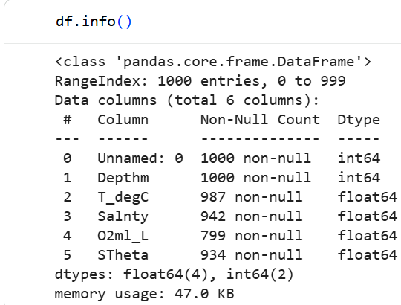
Preparation: Collected and organized the data
Loaded the sub data set into pandas and read the csv file
After describing the csv file I found null values
1000 entries were available in the subset
799 non-null for O2ml_L
942 non-null for Salinity
Cleaned data by creating a new data frame
named filled_null_values
Ensured types for modeling were numeric

Slide 10
Modeling
I chose to build a linear regression model
I built a multi-linear regression model using all the variables in the subset: Depth, T_degC, Salinity, O2ml_L, Stheta, Unnamed: 0
I used the model to predict the amount of dissolved oxygen
Prepared predictions for visualizations

Slide 11
Analyze the Data
I plotted Salnty against O2ml_L on the graph
Salnty (x): independent variable
O2ml_L (y): dependent variable
The points on the scatterplot revealed a downward trend
Scatterplot provided visual confirmation of the negative trend

Slide 12
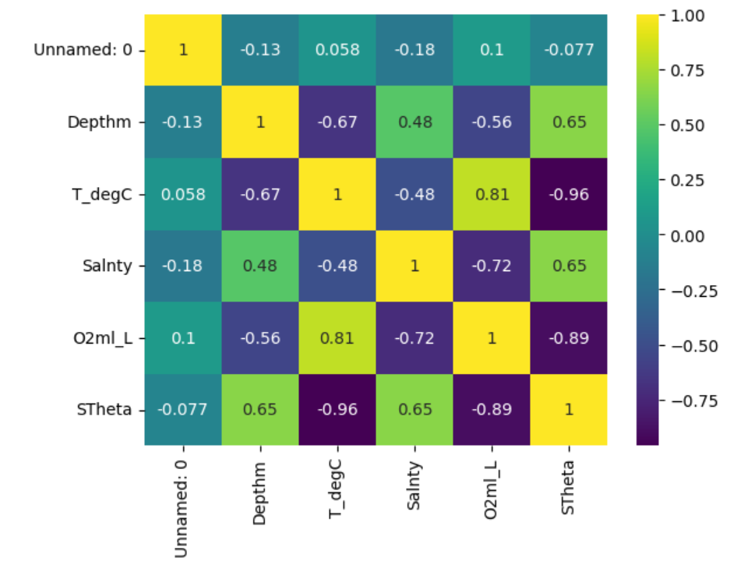

Slide 13
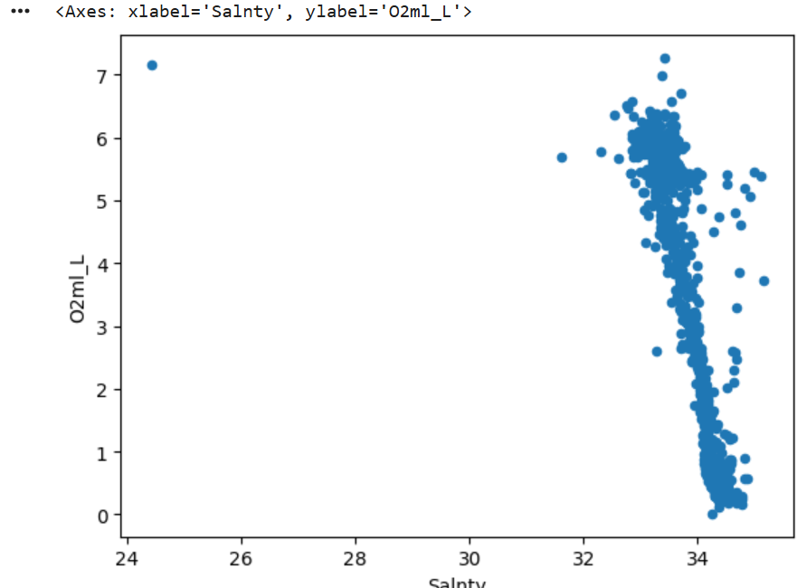
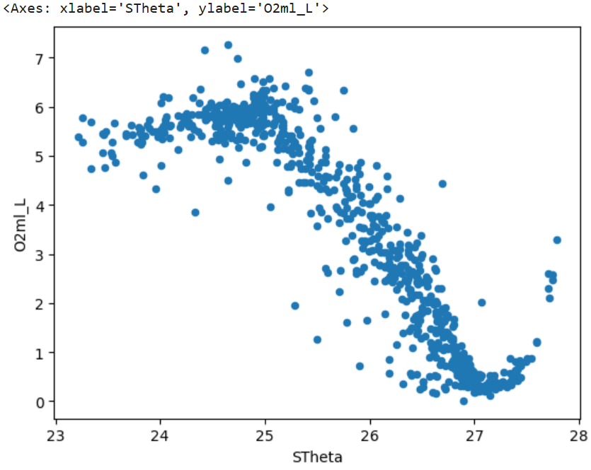
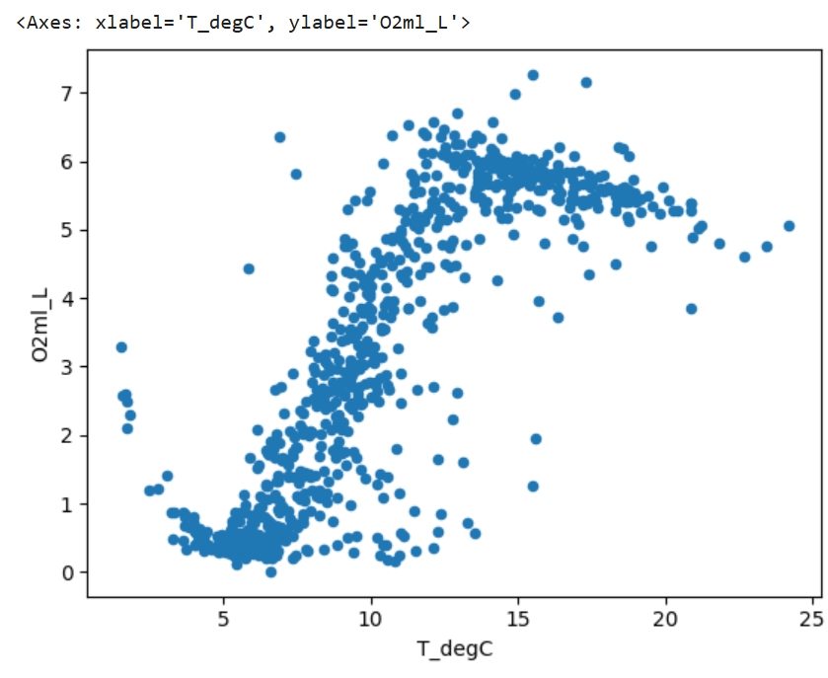
Scatterplot

Slide 14
Analyze the Data: Multi-Linear Regression
Running the model layered the line over the scatterplot
The line proved the negative trend between Salnty and O2ml_L

Slide 15
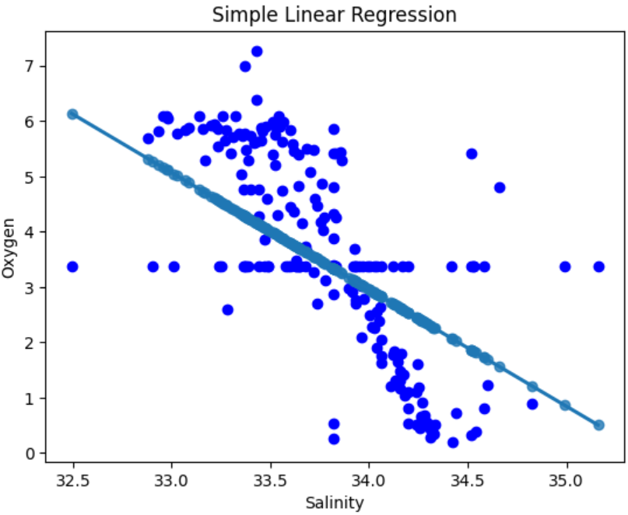
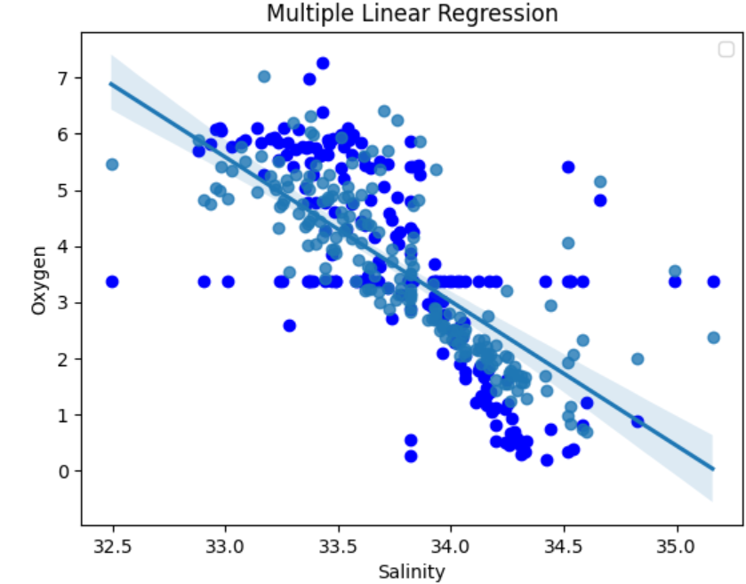
Comparing both models

Slide 16
Interpreting the data
Salinity is a meaningful predictor of oxygen but it’s not the only predictor
There is a definite negative relationship between salinity and oxygen
This is a known ocean process
Both the scatterplot and the linear regression model showed this process

Slide 17
Limitations in my analysis
The model didn’t only use salinity as a predictor
It used all the variables as predictors
Difficult to isolate the effect salinity alone on dissolved oxygen
Dataset doesn’t factor in other ocean masses and mixing, seasons

Slide 18
What I’d do differently if I had more time or data?
Maybe use a simple regression model with just salinity as my predictor
Add other variables: temperature, depth
Maybe try to identify nonlinear relationships
I would have inspect the csv file more to see what the unnamed row signified. I suspect the entire column is just the row number

Slide 19
Key takeaways
definite negative relationship between salinity and oxygen
Higher salinity equates to less oxygen
Salinity is useful as a predictor for oxygen levels
Research question is supported by findings in the model
Useful in understanding patterns along the California coast and coastal patterns in general

Slide 20
Conclusion
Followed the data analytics life cycle for the research process
Cleaned the dataset
Used a linear regression model to interpret the data
Model showed a definite negative relationship between both variables used
The results are useful in understanding the health of the ecosystem along the California coast and other regions

